Slide 1
SIT113 Cloud Computing and Virtualisation
Week 3, Class 1
Azure VMs

Slide 2
Outline
Azure http://portal.azure.com
Accounts
Free
Payments
Dashboard
Subscriptions
Resource Groups
Virtual Machines
Creation
Demonstration

Slide 3
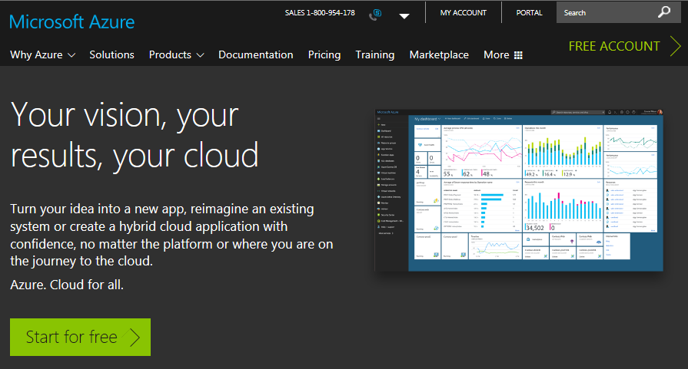
Accounts – Free Account
https://azure.microsoft.com/en-au/

Slide 4
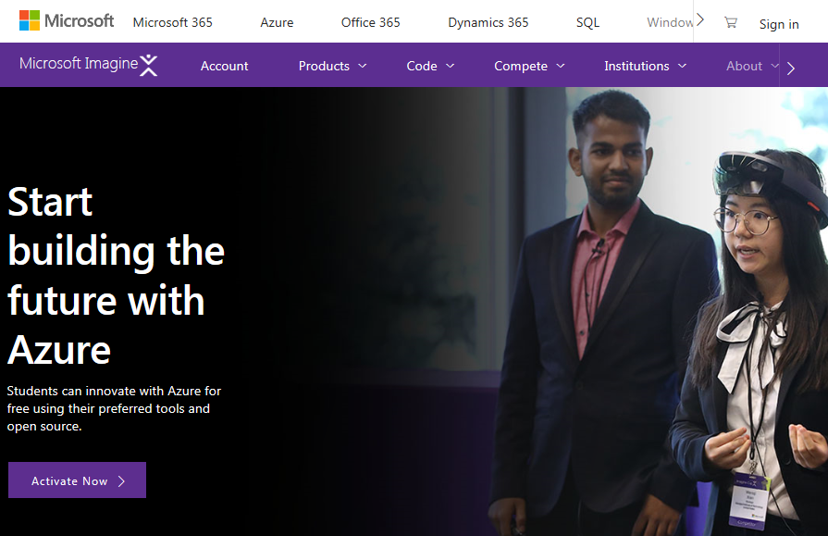
Accounts – Free Account
https://imagine.microsoft.com/

Slide 5
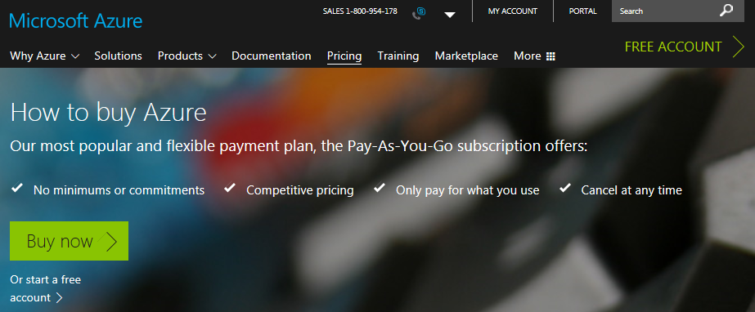
Accounts – Pay As You Go
I created an Azure account using my outlook account: robertdew@outlook.com.au
Provided details:
Personal, Email, Phone, Credit card, Etc.

Slide 6
Azure Portal
http://portal.azure.com/
This is where you can login.
After login, many resources are available such as:
a dashboard
subscriptions
resource groups
virtual machines
and many more

Slide 7
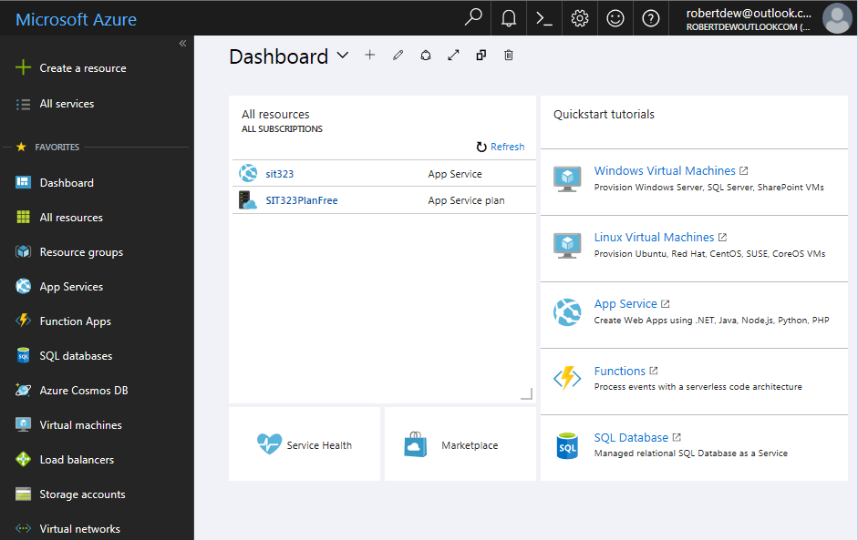
Dashboard

Slide 8
Subscriptions
You can have multiple subscriptions to pay for using Azure resources.
A subscription to pay for personal usage.
Another subscription to pay for work activities.
The following slide shows that Robert has 2 subscriptions:
Microsoft Imagine (some resources for free)
Pay-As-You-Go

Slide 9
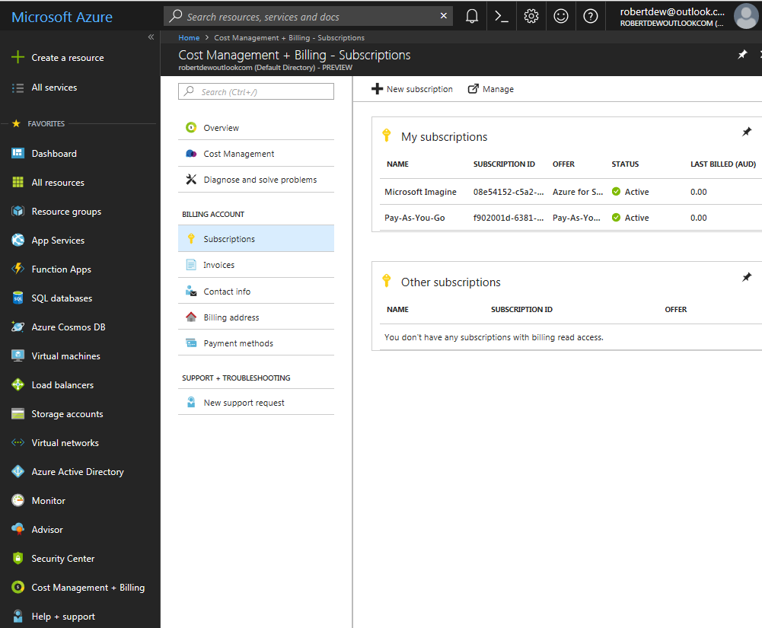
Subscriptions

Slide 10
Resource Groups
A resource group is used to:
group resources that are related in same manner
deploy, manage, and maintain such resources as a single entity
grant access to those resources to others

Slide 11
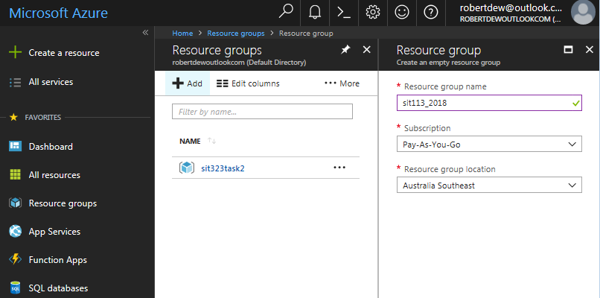
Resource Groups

Slide 12
Virtual Machines
For a virtual machine (VM):
choose one when you need more control of the infrastructure
you don’t buy and maintain the physical hardware
you still need to manage software configure, patch, install
a snapshot of that VM can be created, i.e., a backup of the VM can be created, and later used to resume that VM from that snapshot time

Slide 13
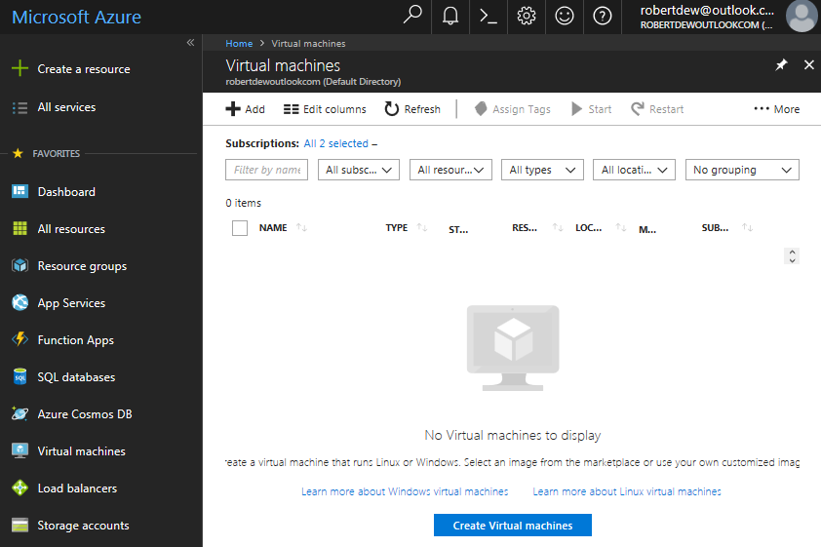
Virtual Machines - Creation

Slide 14
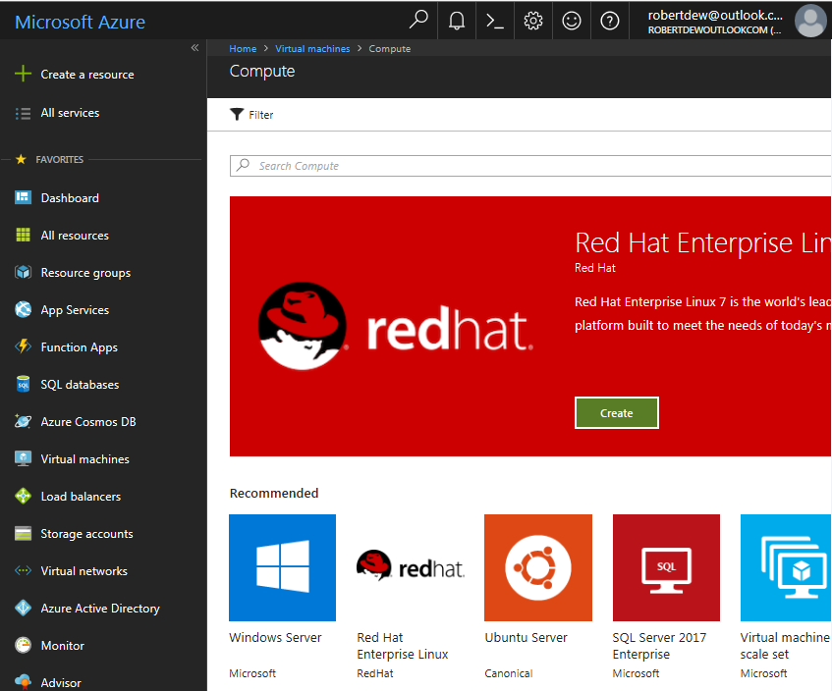
Virtual Machines - Creation
Many VMs to choose from, e.g., Windows Server.

Slide 15
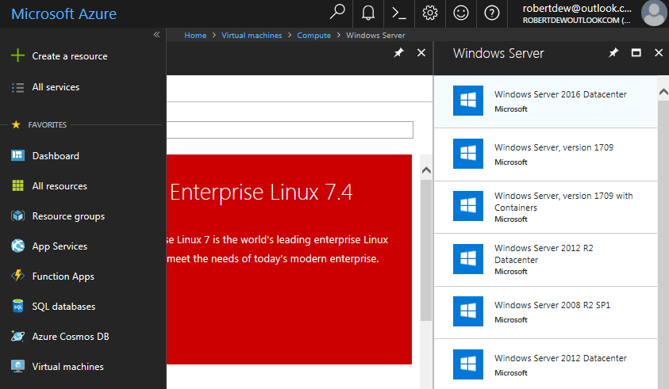
Virtual Machines - Creation
There are many Windows Servers to choose from, e.g., Windows Server 2016 Datacenter

Slide 16
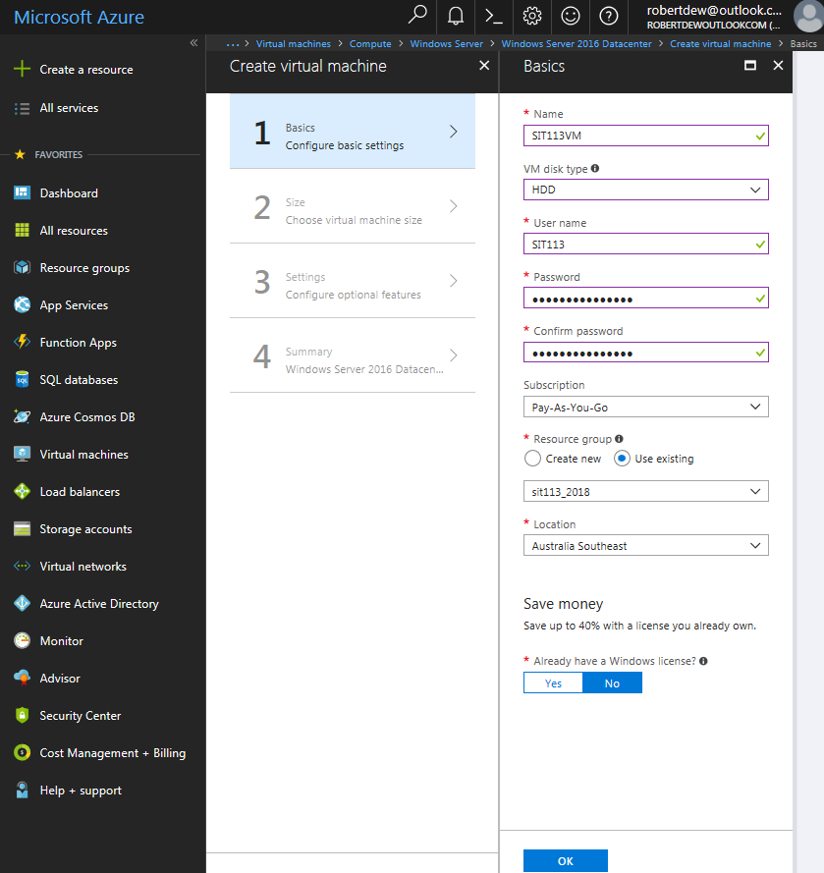
VM Creation – Step 1, Basics
After selecting the machine type, there are 4 steps to create a VM.

Slide 17
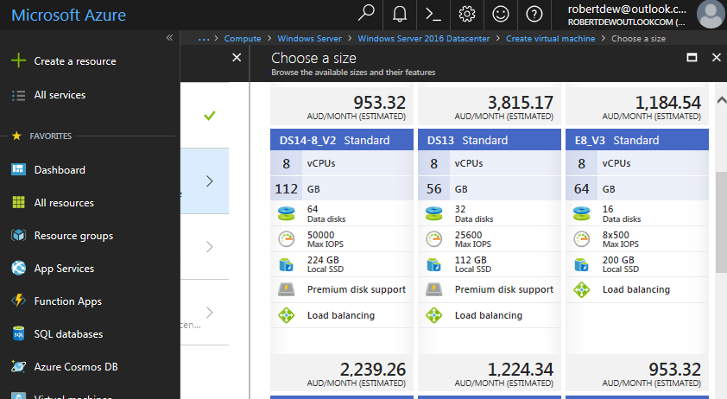
VM Creation – Step 2, Size
There are many sizes to choose from.

Slide 18
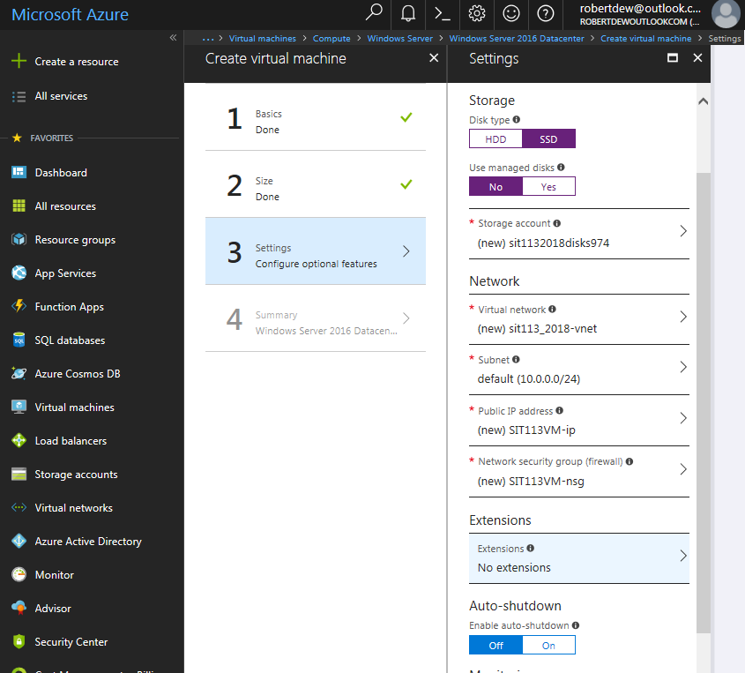
VM Creation – Step 3, Settings

Slide 19
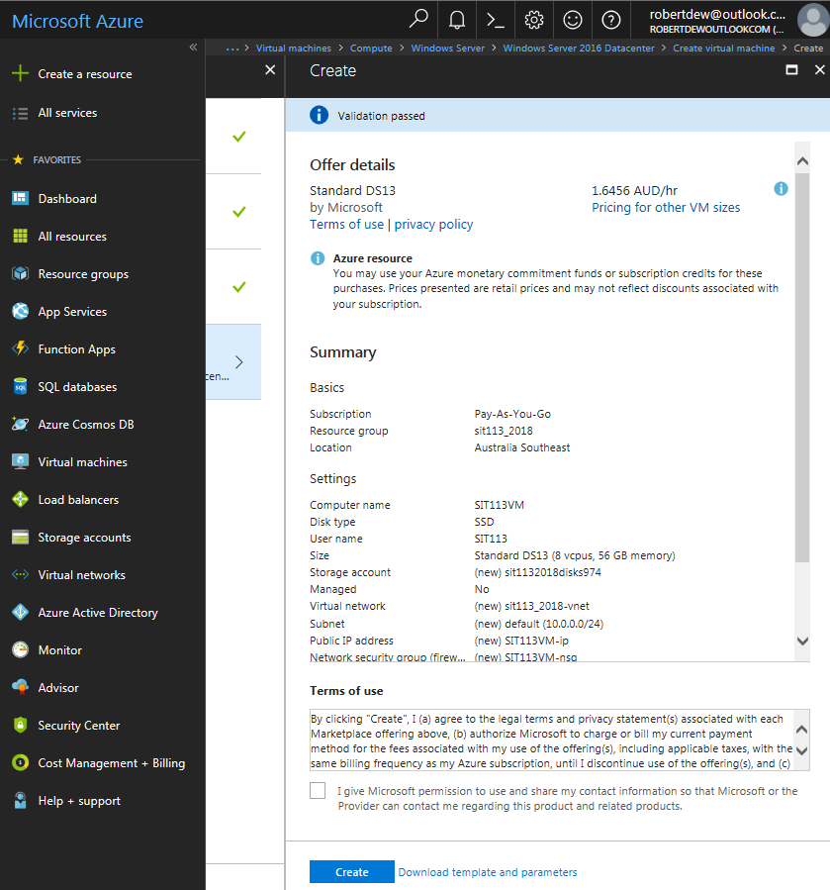
VM Creation – Step 4, Summary
Deployed in about 5 minutes.

Slide 20
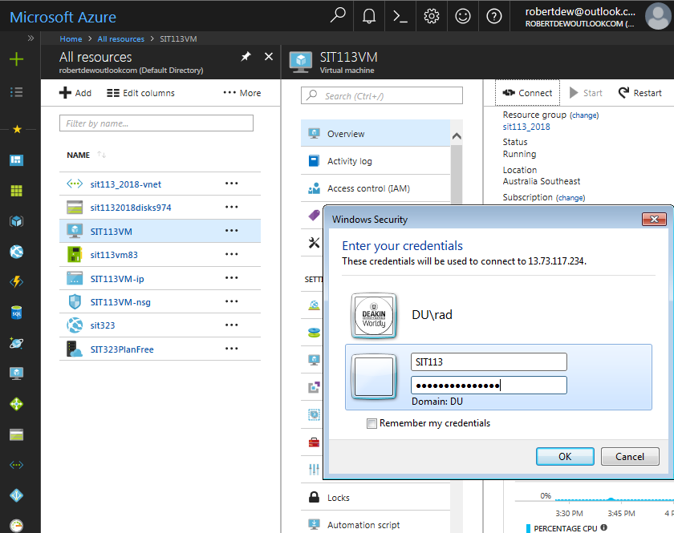
VM - Login

Slide 21
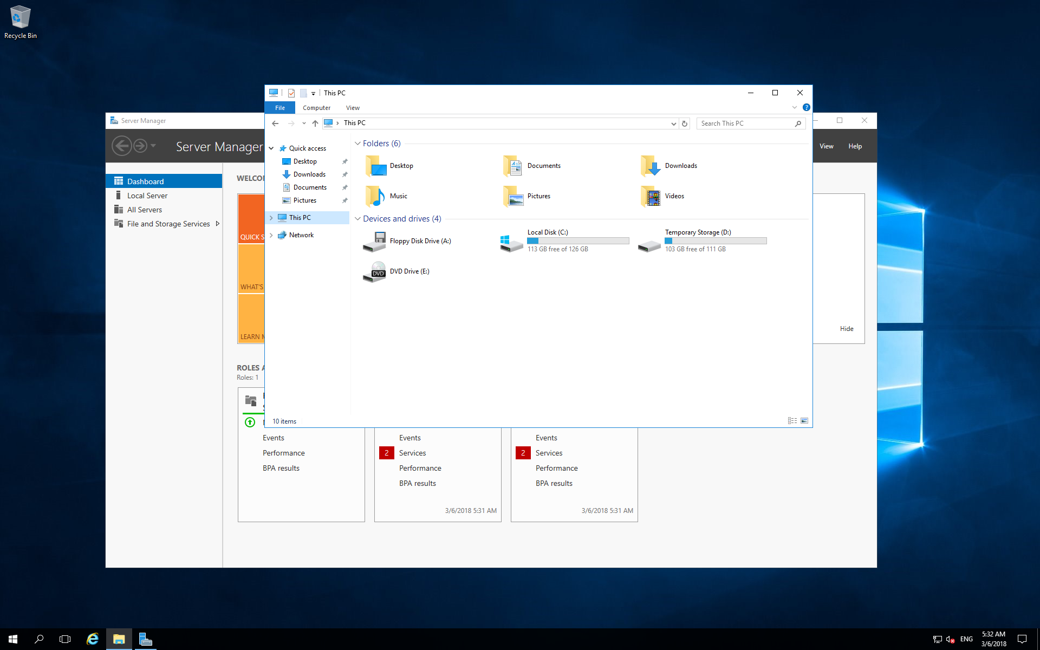
SIT113VM - Remote Desktop

Slide 22
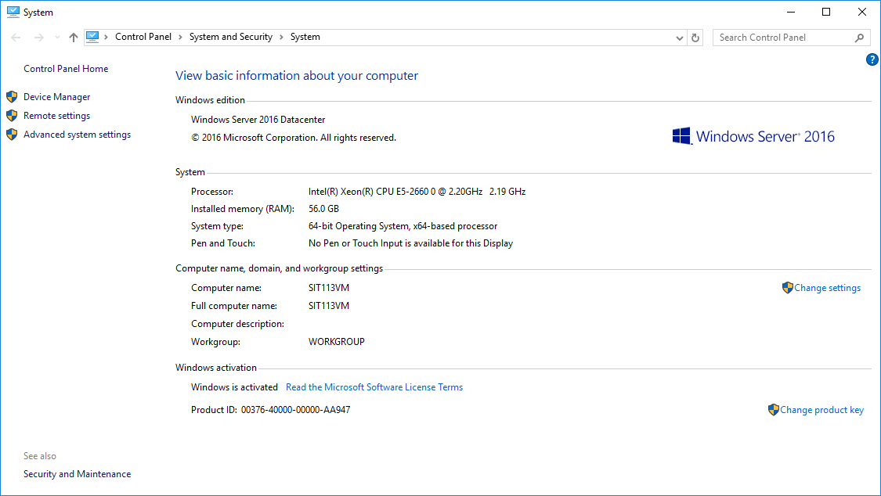
SIT113VM – System Properties

Slide 23
VM - Demonstration
This demonstration will show you:
how to create a VM on Azure
how to remove that VM

Slide 24
Summary
Azure http://portal.azure.com
Accounts
Free
Payments
Dashboard
Subscriptions
Resource Groups
Virtual Machines
Creation
Demonstration

